Slide 1



Cloud Infrastructure Week#1
Emrah Mutlu
January 2024

Slide 2




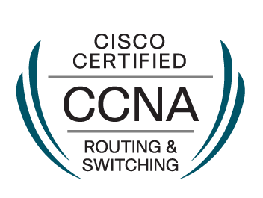
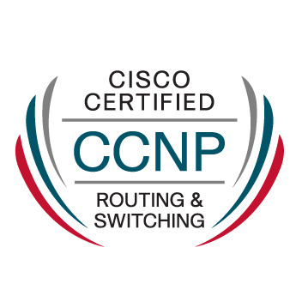


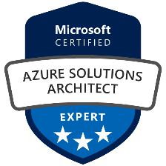

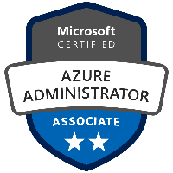
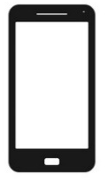




INTRODUCTION - LECTURER
Dokuz Eylul University
Electrical & Electronics Eng. – 2008
Bahcesehir Unv. – MBA – 2019
EMRAH MUTLU
2008 – Nortel Netas: CVoIP Eng.
2013 – Netas: Engineering Team Lead
2014 – Netas: Engineering & CyberSec. Group Manager
2022 – OI Türkiye: Sr. Mgr & CSA
emrah.mutlu@orioninc.com
+90 553 356 4445
Global Support
Unv. Relationship
BI Team
Hiring Team
PoC Team
CSA

Slide 3
AGENDA – Day#1
Introduction to Cloud
Cloud Service Models
Deployment Models
Services
Accounts
Regions
Availability Zones
Lab Session: Creating Free Accounts
Lab Session: Creating a Web Page hosted by Cloud Services
Grading Scale:
Homework: %30
Midterm %30
Final Exam: %40
Answers to bonus questions will be added separately.

Slide 4
Introduction to Cloud

Slide 5
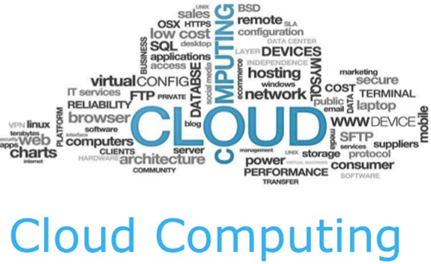
Introductıon to cloud
What is Cloud Computing?
Pay-As-You-Go Model (CapEx vs. OpEx)
Compute & Storage Nodes with efficient use
Scalability & Cost Efficiency
Why is cloud computing typically cheaper to use?
Lower your operating costs.
Run your infrastructure more efficiently.
Scale as your business needs change.
Why should I move to the cloud?
The cloud helps you move faster and innovate in ways that were once nearly impossible.
Teams deliver new features to their users at record speeds.
Users expect an increasingly rich and immersive experience with their devices and with software.
The cloud provides on-demand access to:
A nearly limitless pool of raw compute, storage, and networking components.
Speech recognition and other cognitive services that help make your application stand out from the crowd.
Analytics services that deliver telemetry data from your software and devices.

Slide 6
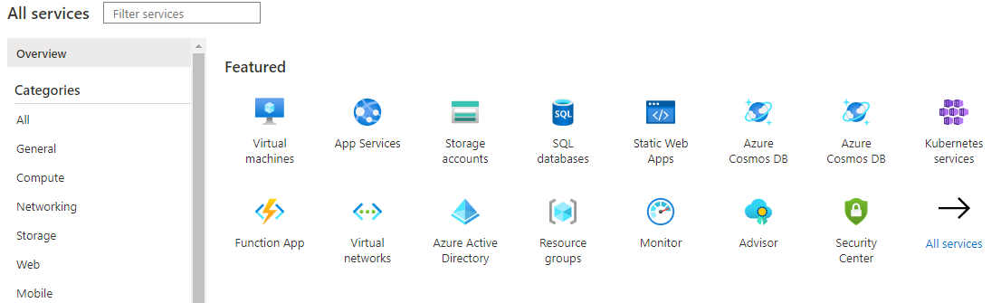
CLOUD COMPUTING FUNDAMENTALS
Azure provides;
IaaS, SaaS and Paas
Pay-As-You-Go Model
VMs
Cloud-Based Storage
Azure-App Services: Scalable hosting platform for Web-based apps.
Azure Functions: Event-driven serverless applications
Azure Container Instances: Allows to deploy containerized apps.
Azure Kubernates Services: Allows to deploy containerized apps.
DBs: SQL, Azure Cosmos DBs, PostgreSQL, etc.
Azure AI & ML and IoT Services
Regional Datacenters for dimensioning
Azure Portal: Configure & Control all Services and Resources in one place

Slide 7
Cloud COMPUTING ADVANTAGES
What are some cloud computing advantages?
Reliability: Depending on the service-level agreement that you choose, your cloud-based applications can provide a continuous user experience with no apparent downtime even when things go wrong.
Availability
The percentage of time that the infrastructure, system, or solution is operational under normal circumstances.
Reliability
The probability that the system will meet certain performance standards and yield correct output for a specific time.

Slide 8
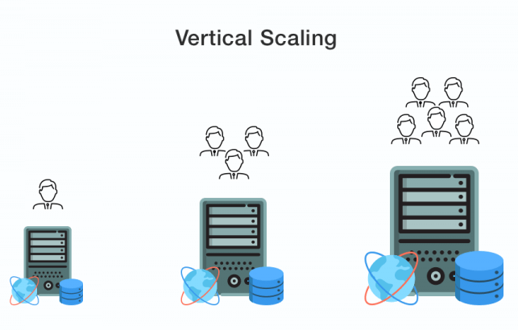
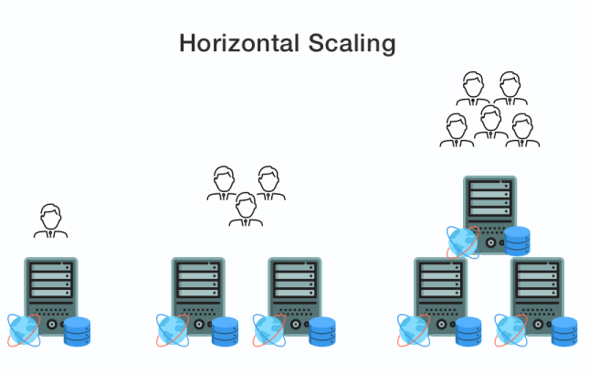
Cloud COMPUTING ADVANTAGES
What are some cloud computing advantages?
Scalability: Applications in the cloud can be scaled in two ways, while taking advantage of autoscaling:
Vertically: Computing capacity can be increased by adding RAM or CPUs to a virtual machine.
Horizontally: Computing capacity can be increased by adding instances of a resource, such as adding more virtual machines to your configuration.

Slide 9
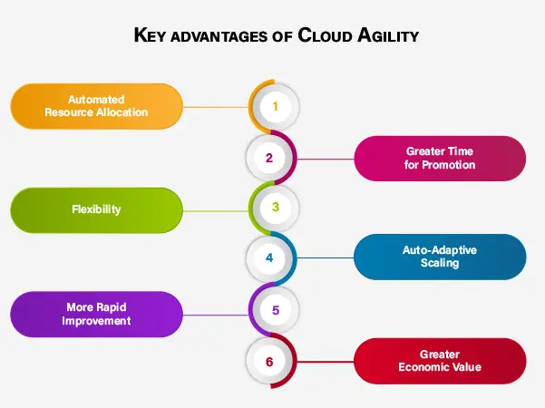
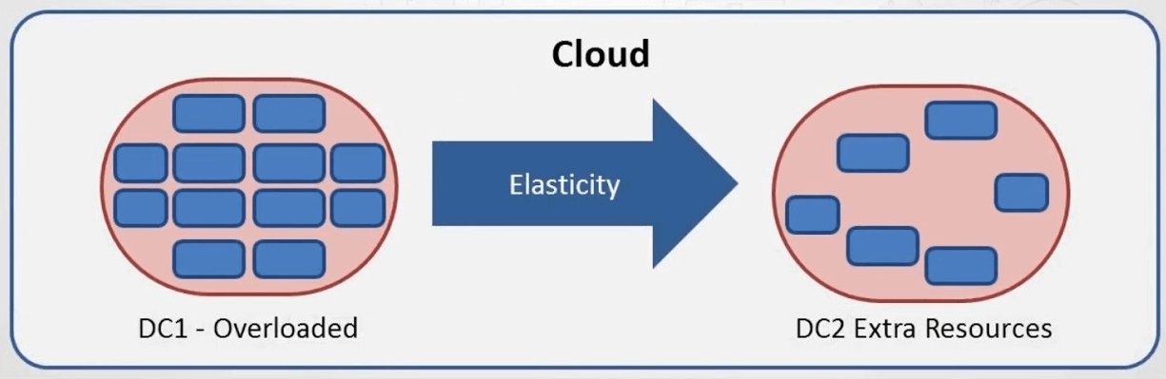
Cloud COMPUTING ADVANTAGES
What are some cloud computing advantages?
Elasticity: Cloud-based applications can be configured to always have the resources they need.
Agility: Cloud-based resources can be deployed and configured quickly as your application requirements change.

Slide 10
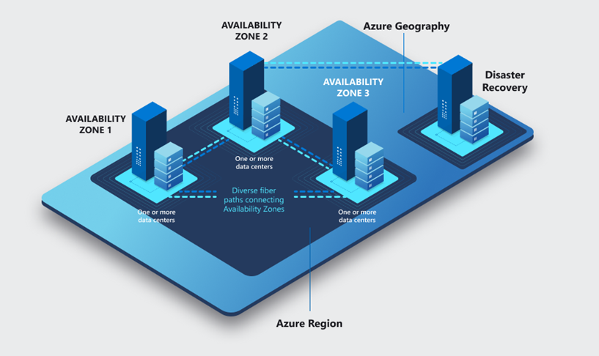
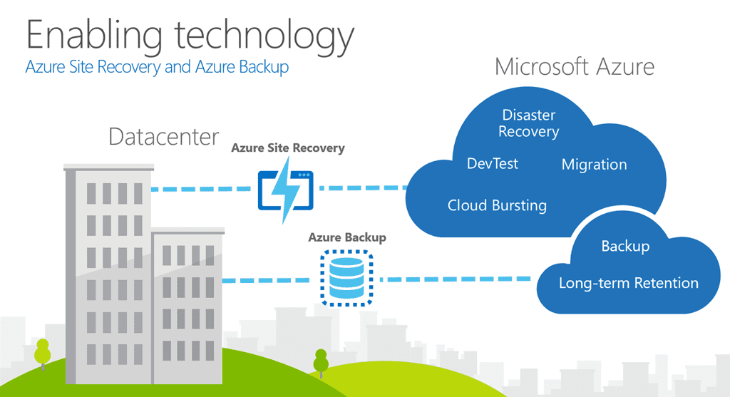
Cloud COMPUTING ADVANTAGES
What are some cloud computing advantages?
Geo-distribution: Applications and data can be deployed to regional datacenters around the globe, so your customers always have the best performance in their region.
Disaster Recovery: By taking advantage of cloud-based backup services, data replication, and geo-distribution, you can deploy your applications with the confidence that comes from knowing that your data is safe in the event that disaster should occur.

Slide 11
Cloud Service Models & Deployment Models & Services

Slide 12
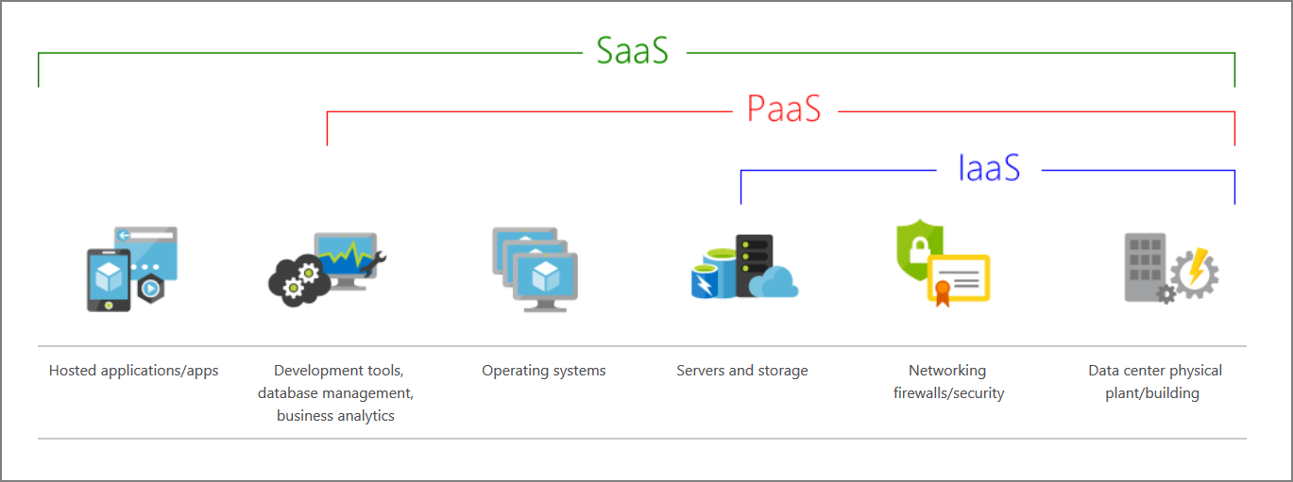
Cloud servıce models
Customer Support
IaaS (Infrastructure as a Service): IaaS provides virtualized computing resources over the internet. It includes virtual machines, storage, and networks.
Example Providers: Amazon Web Services (AWS) Elastic Compute Cloud (EC2), Microsoft Azure Virtual Machines, Google Cloud Platform (GCP) Compute Engine.
PaaS (Platform as a Service): PaaS is a cloud computing service that provides a platform allowing customers to develop, run, and manage applications without dealing with the complexity of building and maintaining the underlying infrastructure.
Example Providers: AWS Lambda, Google App Engine, Microsoft Azure App Service.
SaaS (Software as a Service): SaaS delivers software applications over the internet, eliminating the need for users to install, maintain, and update the software on their devices.
Example Providers: Salesforce, Google Workspace, Microsoft 365, Dropbox.

Slide 13
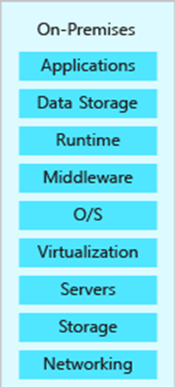
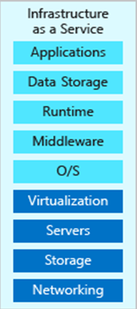
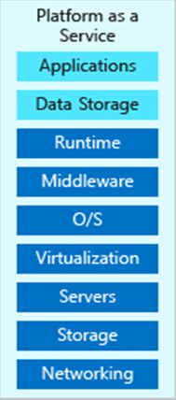
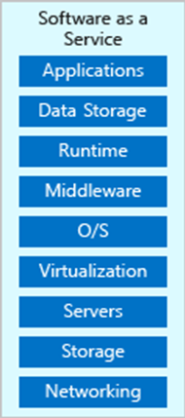

Cloud servıce models – SHARED RESPONSIBILITIES

Slide 14
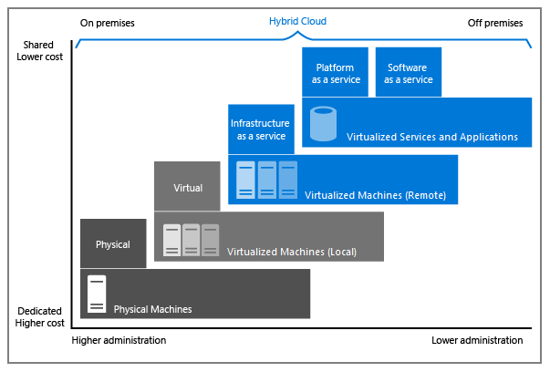
Cloud deployment MODELS
Customer Support
On Premise (Private Cloud): Dedicated, owned type of installation which is managed by the company itself.
Hybrid Cloud: A combination of public cloud and on-premise resources. Mostly preferrable method due to data regulations.
Public Cloud: All resources are on a single public cloud like AWS, Azure, GCP, OCI, Alibaba Cloud. The solution is also called Cloud-Native.
Multi-Cloud: Resources are separated on different Cloud vendors. The most preferrable Cloud-Native solution as it merges the benefits of different vendors.

Slide 15
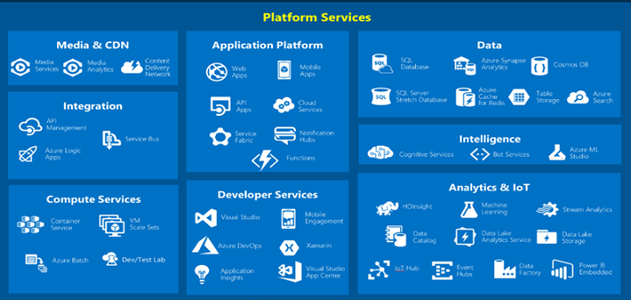
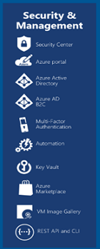
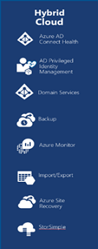
Tour of azure servıces
Customer Support

Slide 16
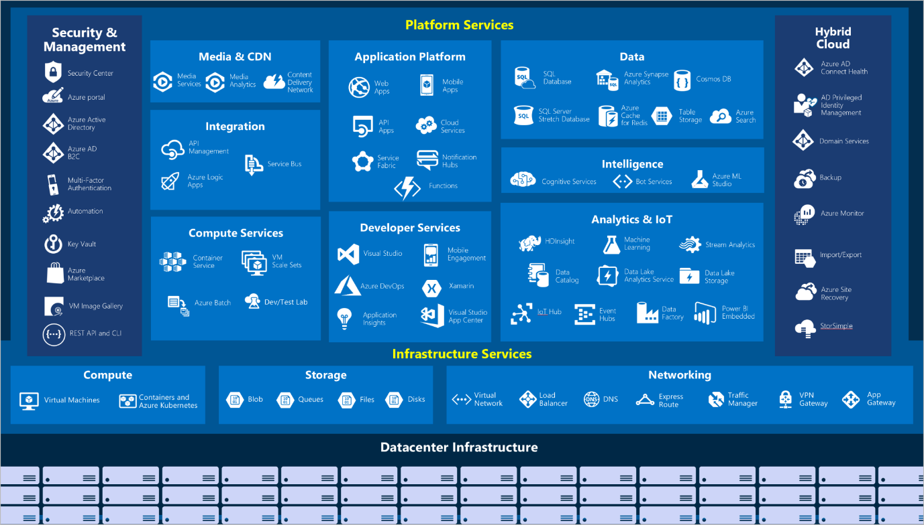
Tour of azure servıces
Customer Support

Slide 17
Accounts

Slide 18
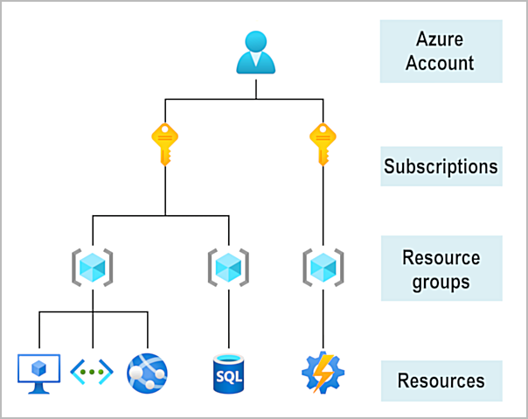
Gettıng started wıth azure accounts
Customer Support
Resources: Cloud resources like compute, storage and database.
Resource Groups: A single resource or a group of resources to build projects.
Subscriptions: A logical container to provision resources.
Azure Account: A single connection that represents all resources and billing sections of a company within Microsoft Azure.

Slide 19
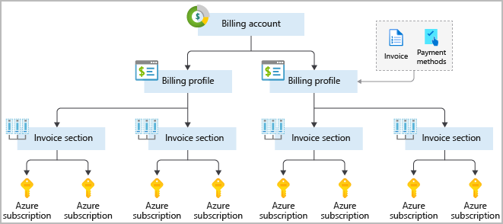
Gettıng started wıth azure accounts
Customer Support
Invoice Section: A single subscription or a group of subscriptions to merge usage fees (i.e. Department based differentiation).
Billing Profile: A combination of invoice sections to merge usage fees (i.e. Sub-company based differentiation).
Billing Account: A single account which is responsible for the whole billing of a company.

Slide 20
Regions & Availability Zones

Slide 21
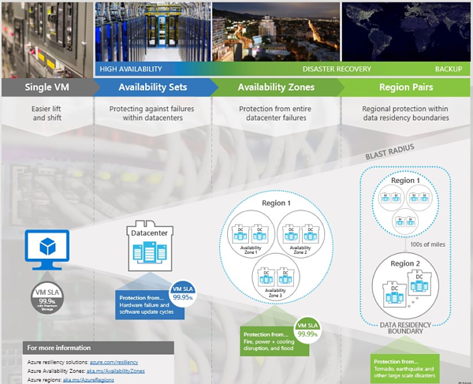
Azure regıons and avaılabılıty zones
Customer Support
Data Center: A physical center that has all the Cloud environment like servers, routers, switches, firewalls, storage solutions, etc.
Availability Zone: A logical zone that contains several data centers to protect against data center failures.
Region: A logical collection of availability zones to protect against natural disasters.
Region Pair: A paired region to build High-Available (HA) solutions.

Slide 22
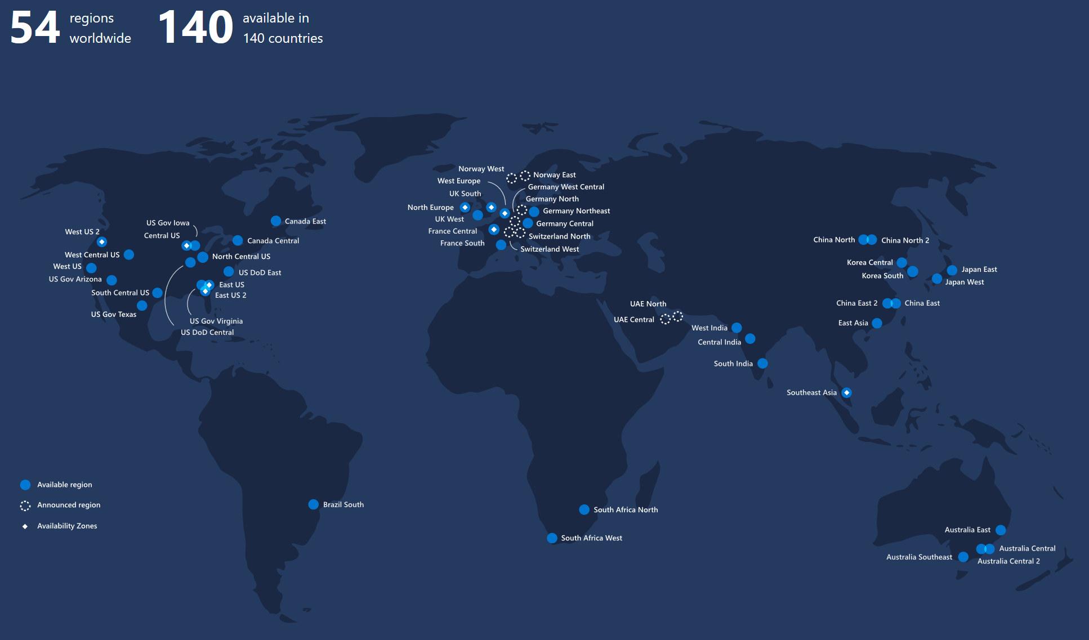
Azure regıons and avaılabılıty zones
Customer Support

Slide 23
Lab Session

Slide 24
LAB#1: CREATING FREE ACCOUNTS
Follow the instructions: https://azure.microsoft.com/en-us/free

Slide 25
LAB#2: Creating a Web Page hosted by Cloud Services
- IaaS Example: LAMP Server installation
Follow the provided instructions…

Slide 26
HOMEWORK
Try to learn the AWS equivalents of services. Provide a short summary.
Try to perform alternative Web Hosting services on Azure and provide a short summary about how you can do it (Tip: There are several ways).
Try to learn more about Linux OS:
https://www.youtube.com/watch?v=ROjZy1WbCIA (Basic course, 3 hours watch)
https://training.linuxfoundation.org/training/introduction-to-linux/ (Free course, optional to learn more about Linux, 60 hours of training material).

Slide 27
Thank You

